Slide 1

Application layer: overview
P2P applications
video streaming and content distribution networks
socket programming with UDP and TCP
Principles of network applications
Web and HTTP
E-mail, SMTP, IMAP
The Domain Name System DNS

Slide 2
Web and HTTP
Web or webpage
web page consists of objects, each of which can be stored on different Web servers
object can be HTML file, JPEG image, Java applet, audio file,…
web page consists of base HTML-file which includes several referenced objects, each addressable by a URL, e.g.,
Website
Collection of webpages hosted in a web server.
www.ritrjpm.ac.in/someDept/pic.gif
host name
path name

Slide 3


HTTP overview
HTTP: hypertext transfer protocol
Web’s application-layer protocol
client/server model:
client: browser that requests, receives, (using HTTP protocol) and “displays” Web objects
server: Web server sends (using HTTP protocol) objects in response to requests
HTTP request
PC running
Firefox browser
HTTP response
HTTP request
server running
Apache Web
server
HTTP response
iPhone running
Safari browser

Slide 4
HTTP overview (continued)
HTTP uses TCP:
client initiates TCP connection (creates socket) to server, port 80
server accepts TCP connection from client
HTTP messages (application-layer protocol messages) exchanged between browser (HTTP client) and Web server (HTTP server)
TCP connection closed
HTTP is “stateless”
server maintains no information about past client requests
aside
protocols that maintain “state” are complex!
past history (state) must be maintained
if server/client crashes, their views of “state” may be inconsistent, must be reconciled

Slide 5
HTTP connections: two types
Non-persistent HTTP
TCP connection opened
at most one object sent over TCP connection
TCP connection closed
downloading multiple objects required multiple connections
Persistent HTTP
TCP connection opened to a server
multiple objects can be sent over single TCP connection between client, and that server
TCP connection closed

Slide 6
Non-persistent HTTP: example
User enters URL:
www.someSchool.edu/someDepartment/home.index
(containing text, references to 10 jpeg images)
1a. HTTP client initiates TCP connection to HTTP server (process) at www.someSchool.edu on port 80
1b. HTTP server at host www.someSchool.edu waiting for TCP connection at port 80 “accepts” connection, notifying client
2. HTTP client sends HTTP request message (containing URL) into TCP connection socket. Message indicates that client wants object someDepartment/home.index
3. HTTP server receives request message, forms response message containing requested object, and sends message into its socket
time

Slide 7
Non-persistent HTTP: example (cont.)
User enters URL:
www.someSchool.edu/someDepartment/home.index
(containing text, references to 10 jpeg images)
4. HTTP server closes TCP connection.
5. HTTP client receives response message containing html file, displays html. Parsing html file, finds 10 referenced jpeg objects
6. Steps 1-5 repeated for each of 10 jpeg objects
time

Slide 8
Three-way handshake protocol
1a The client sends a small TCP segment to the server
1b The server acknowledges and responds with a small TCP segment
2. the client acknowledges back to the server
time
The first two parts of the three-way handshake take one RTT(1a+1b).

Slide 9
Non-persistent HTTP: response time
Round Trip Time(RTT) (definition): time for a small packet to travel from client to server and then back to the client
HTTP response time (per object):
one RTT to initiate TCP connection
one RTT for HTTP request and first few bytes of HTTP response to return
object/file transmission time
initiate TCP
connection
RTT
request file
RTT
time to
transmit
file
file received
time
time
Non-persistent HTTP response time = 2RTT+ file transmission time

Slide 10
Persistent HTTP (HTTP 1.1)
Non-persistent HTTP issues:
requires 2 RTTs per object
OS overhead for each TCP connection
browsers often open multiple parallel TCP connections to fetch referenced objects in parallel
Persistent HTTP (HTTP1.1):
server leaves connection open after sending response
subsequent HTTP messages between same client/server sent over open connection
client sends requests as soon as it encounters a referenced object
as little as one RTT for all the referenced objects (cutting response time in half)

Slide 11
HTTP request message
two types of HTTP messages: request, response
HTTP request message:
ASCII (human-readable format)
carriage return character
request line (GET, POST,
HEAD commands)
line-feed character
GET /index.html HTTP/1.1\r\n
Host: www-net.cs.umass.edu\r\n
User-Agent: Mozilla/5.0 (Macintosh; Intel Mac OS X 10.15; rv:80.0) Gecko/20100101 Firefox/80.0 \r\n
Accept: text/html,application/xhtml+xml\r\n
Accept-Language: en-us,en;q=0.5\r\n
Accept-Encoding: gzip,deflate\r\n
Connection: keep-alive\r\n
\r\n
header
lines
carriage return, line feed at start of line indicates end of header lines
* Check out the online interactive exercises for more examples: http://gaia.cs.umass.edu/kurose_ross/interactive/

Slide 12
HTTP request message: general format
method
sp
URL
sp
version
cr
lf
request
line
header field name
value
cr
lf
~
~
header
lines
~
~
header field name
value
cr
lf
cr
lf
~
entity body
~
body
~
~

Slide 13
Other HTTP request messages
POST method:
web page often includes form input
user input sent from client to server in entity body of HTTP POST request message
HEAD method:
requests headers (only) that would be returned if specified URL were requested with an HTTP GET method.
PUT method:
uploads new file (object) to server
completely replaces file that exists at specified URL with content in entity body of POST HTTP request message
GET method (for sending data to server):
include user data in URL field of HTTP GET request message (following a ‘?’):
www.somesite.com/animalsearch?monkeys&banana

Slide 14
HTTP response message
status line (protocol
status code status phrase)
HTTP/1.1 200 OK
Date: Tue, 08 Sep 2020 00:53:20 GMT
Server: Apache/2.4.6 (CentOS) OpenSSL/1.0.2k-fips PHP/7.4.9 mod_perl/2.0.11 Perl/v5.16.3
Last-Modified: Tue, 01 Mar 2016 18:57:50 GMT
ETag: "a5b-52d015789ee9e"
Accept-Ranges: bytes
Content-Length: 2651
Content-Type: text/html; charset=UTF-8
\r\n
data data data data data ...
header
lines
data, e.g., requested
HTML file
* Check out the online interactive exercises for more examples: http://gaia.cs.umass.edu/kurose_ross/interactive/

Slide 15
HTTP response status codes
status code appears in 1st line in server-to-client response message.
some sample codes:
200 OK
request succeeded, requested object later in this message
301 Moved Permanently
requested object moved, new location specified later in this message (in Location: field)
400 Bad Request
request msg not understood by server
404 Not Found
requested document not found on this server
505 HTTP Version Not Supported

Slide 16
Trying out HTTP (client side) for yourself
1. netcat to your favorite Web server:
% nc -c -v gaia.cs.umass.edu 80
opens TCP connection to port 80 (default HTTP server port) at gaia.cs.umass. edu.
anything typed in will be sent to port 80 at gaia.cs.umass.edu
2. type in a GET HTTP request:
GET /kurose_ross/interactive/index.php HTTP/1.1
Host: gaia.cs.umass.edu
by typing this in (hit carriage return twice), you send this minimal (but complete) GET request to HTTP server
3. look at response message sent by HTTP server!
(or use Wireshark to look at captured HTTP request/response)

Slide 17
Http / Web server configuration in cisco packet tracer
https://www.youtube.com/watch?v=vyzvdbnOTXY

Slide 18

Maintaining user/server state: cookies
Recall: HTTP GET/response interaction is stateless
no notion of multi-step exchanges of HTTP messages to complete a Web “transaction”
no need for client/server to track “state” of multi-step exchange
all HTTP requests are independent of each other
no need for client/server to “recover” from a partially-completed-but-never-completely-completed transaction
a stateful protocol: client makes two changes to X, or none at all
X
lock data record X
X
OK
update X X’
X’
OK
t’
update X X’’
OK
X’’
unlock X
OK
X’’
time
time
Q: what happens if network connection or client crashes at t’ ?
Notes:
t’

Slide 19
Maintaining user/server state: cookies
Web sites and client browser use cookies to maintain some state between transactions
four components:
1) cookie header line of HTTP response message
2) cookie header line in next HTTP request message
3) cookie file kept on user’s host, managed by user’s browser
4) back-end database at Web site
Example:
Susan uses browser on laptop, visits specific e-commerce site for first time
when initial HTTP requests arrives at site, site creates:
unique ID (aka “cookie”)
entry in backend database for ID
subsequent HTTP requests from Susan to this site will contain cookie ID value, allowing site to “identify” Susan
Notes:
t’

Slide 20
Maintaining user/server state: cookies
client
server
ebay 8734
usual HTTP request msg
Amazon server
creates ID
1678 for user
cookie file
usual HTTP response
set-cookie: 1678
backend
database
create
entry
ebay 8734
amazon 1678
usual HTTP request msg
cookie: 1678
cookie-
specific
action
access
usual HTTP response msg
one week later:
access
ebay 8734
amazon 1678
usual HTTP request msg
cookie: 1678
cookie-
specific
action
usual HTTP response msg
time
time
Notes:
t’

Slide 21
HTTP cookies: comments
aside
What cookies can be used for:
authorization
shopping carts
recommendations
user session state (Web e-mail)
cookies and privacy:
cookies permit sites to learn a lot about you on their site.
third party persistent cookies (tracking cookies) allow common identity (cookie value) to be tracked across multiple web sites
Challenge: How to keep state?
at protocol endpoints: maintain state at sender/receiver over multiple transactions
in messages: cookies inHTTP messages carry state
Notes:
t’

Slide 22
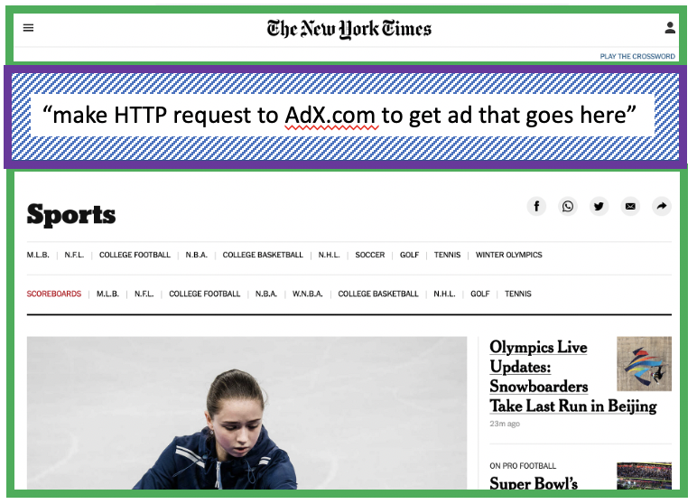
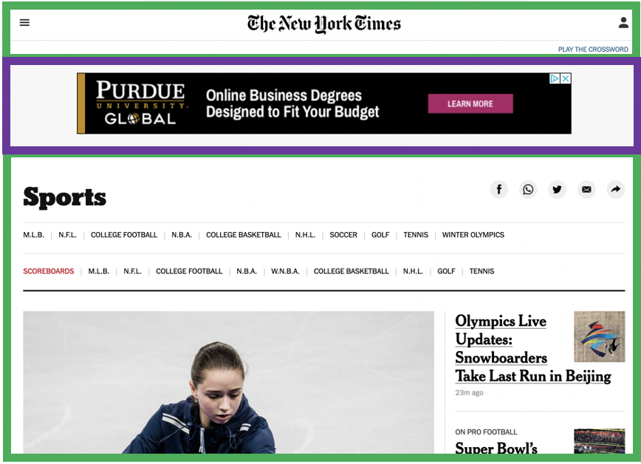


Example: displaying a NY Times web page
1
GET base html file from nytimes.com
2
fetch ad from AdX.com
nytimes.com
4
5
HTTP GET
1
2
HTTP reply
7
display composed page
3
4
6
5
NY times page with embedded ad displayed
AdX.com

Slide 23
Cookies: tracking a user’s browsing behavior
1634: sports, 2/15/22
nytimes.com (sports)
“first party” cookie – from website you chose to visit (provides base html file)
HTTP
GET
HTTP reply
Set cookie: 1634
HTTP GET
Referer: NY Times Sports
4
5
7493: NY Times sports, 2/15/22
“third party” cookie – from website you did not choose to visit
HTTP reply
NY Times: 1634
Set cookie: 7493
AdX.com
AdX: 7493

Slide 24
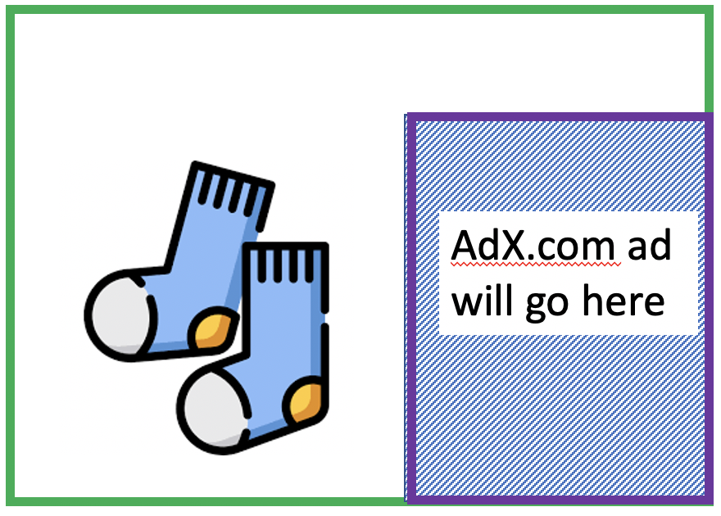
Cookies: tracking a user’s browsing behavior
1634: sports, 2/15/22
nytimes.com
AdX:
tracks my web browsing over sites with AdX ads
can return targeted ads based on browsing history
socks.com
HTTP reply
2
HTTP GET
1
HTTP GET
Referer: socks.com, cookie: 7493
4
7493: NY Times sports, 2/15/22
5
7493: socks.com, 2/16/22
HTTP reply
NY Times: 1634
Set cookie: 7493
AdX.com
AdX: 7493

Slide 25

Cookies: tracking a user’s browsing behavior (one day later)
1634: sports, 2/15/22
1634: arts, 2/17/22
nytimes.com (arts)
socks.com
HTTP
GET
HTTP reply
cookie: 1634
Set cookie: 1634
HTTP GET
Referer:nytimes.com, cookie: 7493
4
7493: NY Times sports, 2/15/22
5
7493: socks.com, 2/16/22
HTTP reply
7493: NY Times arts, 2/15/22
NY Times: 1634
Set cookie: 7493
AdX.com
AdX: 7493
Returned ad for socks!

Slide 26
Cookies: tracking a user’s browsing behavior
Cookies can be used to:
track user behavior on a given website (first party cookies)
track user behavior across multiple websites (third party cookies) without user ever choosing to visit tracker site (!)
tracking may be invisible to user:
rather than displayed ad triggering HTTP GET to tracker, could be an invisible link
third party tracking via cookies:
disabled by default in Firefox, Safari browsers
to be disabled in Chrome browser in 2023

Slide 27
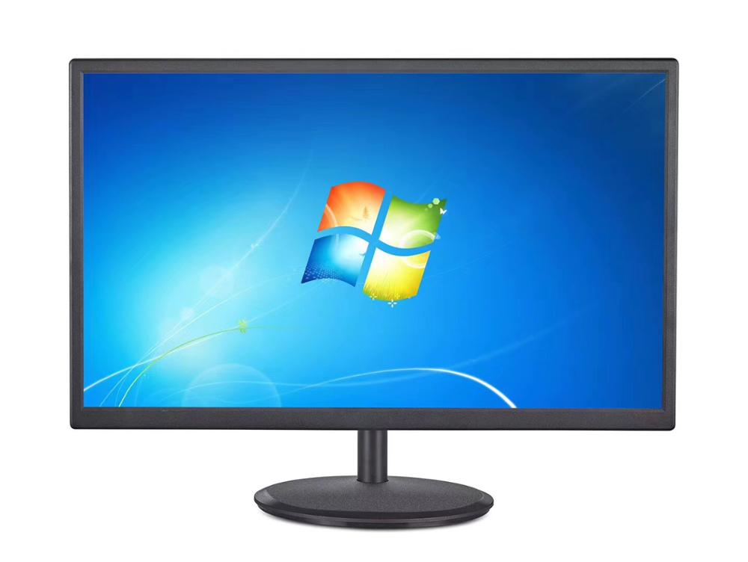
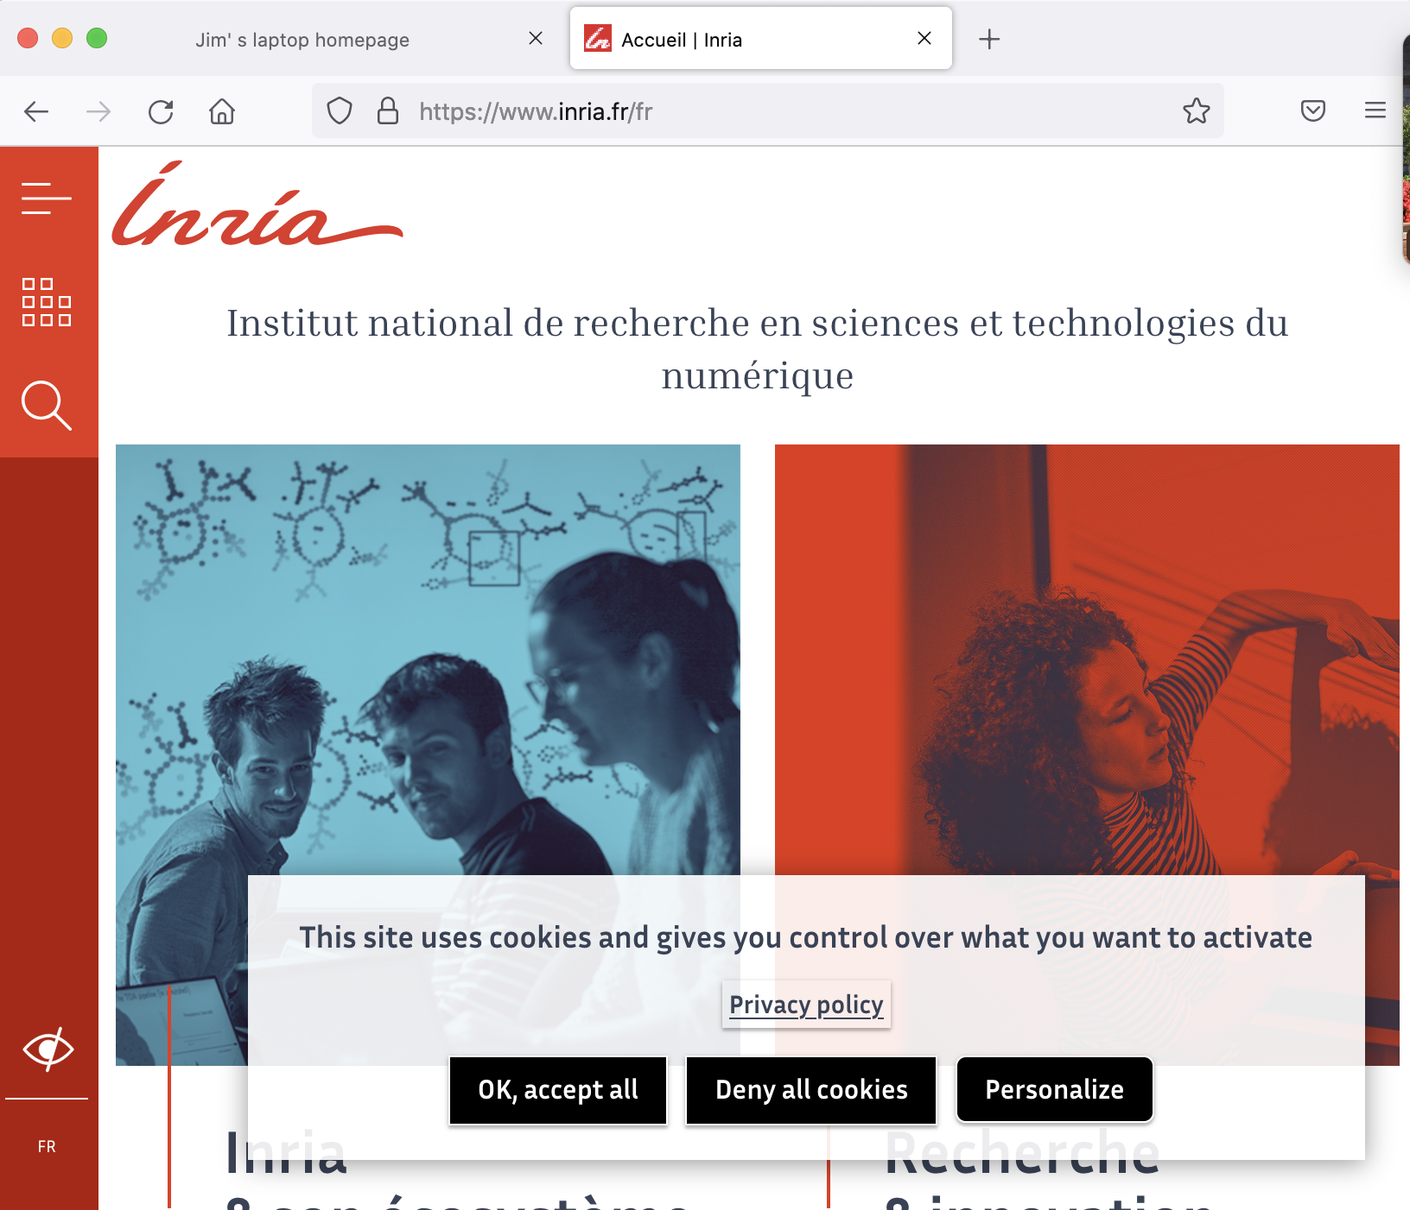
GDPR (EU General Data Protection Regulation) and cookies
“Natural persons may be associated with online identifiers […] such as internet protocol addresses, cookie identifiers or other identifiers […].
This may leave traces which, in particular when combined with unique identifiers and other information received by the servers, may be used to create profiles of the natural persons and identify them.”
GDPR, recital 30 (May 2018)
when cookies can identify an individual, cookies are considered personal data, subject to GDPR personal data regulations
User has explicit control over whether or not cookies are allowed

Slide 28

Web caches
Goal: satisfy client requests without involving origin server
user configures browser to point to a (local) Web cache
browser sends all HTTP requests to cache
if object in cache: cache returns object to client
else cache requests object from origin server, caches received object, then returns object to client
Web
cache
HTTP request
HTTP request
client
HTTP response
HTTP response
origin
server
HTTP request
HTTP response
client
Notes:
t’

Slide 29
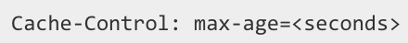

Web caches (aka proxy servers)
Web cache acts as both client and server
server for original requesting client
client to origin server
Why Web caching?
reduce response time for client request
cache is closer to client
reduce traffic on an institution’s access link
Internet is dense with caches
enables “poor” content providers to more effectively deliver content
server tells cache about object’s allowable caching in response header:
Notes:
re: poor content providers – like in real-estate, location is everything. servers want to be close to clients.

Slide 30
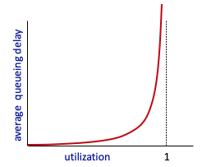


Caching example
Scenario:
access link rate: 1.54 Mbps
RTT from institutional router to server: 2 sec
web object size: 100K bits
average request rate from browsers to origin servers: 15/sec
avg data rate to browsers: 1.50 Mbps
origin
servers
public
Internet
1.54 Mbps
access link
Performance:
access link utilization = .97
LAN utilization: .0015
end-end delay = Internet delay +
access link delay + LAN delay
= 2 sec + minutes + usecs
problem: large queueing delays at high utilization!
institutional
network
1 Gbps LAN
Notes:
explain why minutes (recall earlier delay versus arrival rate curve from Chapter 1)

Slide 31
Option 1: buy a faster access link
Scenario:
access link rate: 1.54 Mbps
RTT from institutional router to server: 2 sec
web object size: 100K bits
average request rate from browsers to origin servers: 15/sec
avg data rate to browsers: 1.50 Mbps
154 Mbps
origin
servers
public
Internet
154 Mbps
1.54 Mbps
access link
Performance:
access link utilization = .97
LAN utilization: .0015
end-end delay = Internet delay +
access link delay + LAN delay
= 2 sec + minutes + usecs
.0097
institutional
network
1 Gbps LAN
Cost: faster access link (expensive!)
msecs
Notes:
t’

Slide 32
Option 2: install a web cache
Scenario:
access link rate: 1.54 Mbps
RTT from institutional router to server: 2 sec
web object size: 100K bits
average request rate from browsers to origin servers: 15/sec
avg data rate to browsers: 1.50 Mbps
origin
servers
public
Internet
1.54 Mbps
access link
Cost: web cache (cheap!)
institutional
network
Performance:
LAN utilization: .?
access link utilization = ?
average end-end delay = ?
1 Gbps LAN
How to compute link
utilization, delay?
local web cache
Notes:
t’

Slide 33
Calculating access link utilization, end-end delay with cache:
suppose cache hit rate is 0.4:
40% requests served by cache, with low (msec) delay
60% requests satisfied at origin
origin
servers
public
Internet
60% requests satisfied at origin
rate to browsers over access link
= 0.6 * 1.50 Mbps = .9 Mbps
access link utilization = 0.9/1.54 = .58 means low (msec) queueing delay at access link
1.54 Mbps
access link
institutional
network
average end-end delay:
= 0.6 * (delay from origin servers)
+ 0.4 * (delay when satisfied at cache)
= 0.6 (2.01) + 0.4 (~msecs) = ~ 1.2 secs
1 Gbps LAN
local web cache
lower average end-end delay than with 154 Mbps link (and cheaper too!)
Notes:
t’

Slide 34
Browser caching: Conditional GET
client
server
Goal: don’t send object if browser has up-to-date cached version
no object transmission delay (or use of network resources)
client: specify date of browser-cached copy in HTTP request
If-modified-since: <date>
server: response contains no object if browser-cached copy is up-to-date:
HTTP/1.0 304 Not Modified
HTTP request msg
If-modified-since: <date>
object
not
modified
before
<date>
HTTP response
HTTP/1.0
304 Not Modified
HTTP request msg
If-modified-since: <date>
object
modified
after
<date>
HTTP response
HTTP/1.0 200 OK
<data>
Notes:
t’

Slide 35
HTTP/2
Key goal: decreased delay in multi-object HTTP requests
HTTP1.1: introduced multiple, pipelined GETs over single TCP connection
server responds in-order (FCFS: first-come-first-served scheduling) to GET requests
with FCFS, small object may have to wait for transmission (head-of-line (HOL) blocking) behind large object(s)
loss recovery (retransmitting lost TCP segments) stalls object transmission
Notes:
t’

Slide 36
HTTP/2
Key goal: decreased delay in multi-object HTTP requests
HTTP/2: [RFC 7540, 2015] increased flexibility at server in sending objects to client:
methods, status codes, most header fields unchanged from HTTP 1.1
transmission order of requested objects based on client-specified object priority (not necessarily FCFS)
push unrequested objects to client
divide objects into frames, schedule frames to mitigate HOL blocking
Notes:
t’

Slide 37
HTTP/2: mitigating HOL blocking
HTTP 1.1: client requests 1 large object (e.g., video file) and 3 smaller objects
server
GET O₄
GET O₃
GET O₂
GET O₁
object data requested
client
O₁
O₂
O₁
O₃
O₂
O₃
O₄
O₄
objects delivered in order requested: O₂, O₃, O₄ wait behind O₁
Notes:
t’

Slide 38
HTTP/2: mitigating HOL blocking
HTTP/2: objects divided into frames, frame transmission interleaved
server
GET O₄
GET O₃
GET O₂
GET O₁
object data requested
client
O₂
O₄
O₃
O₁
O₂
O₃
O₄
O₁
O₂, O₃, O₄ delivered quickly, O₁ slightly delayed
Notes:
shortest job first: decreased average delay!

Slide 39
HTTP/2 to HTTP/3
HTTP/2 over single TCP connection means:
recovery from packet loss still stalls all object transmissions
as in HTTP 1.1, browsers have incentive to open multiple parallel TCP connections to reduce stalling, increase overall throughput
no security over vanilla TCP connection
HTTP/3: adds security, per object error- and congestion-control (more pipelining) over UDP
more on HTTP/3 in transport layer
Notes:
t’

Slide 40
Application layer: overview
P2P applications
video streaming and content distribution networks
socket programming with UDP and TCP
Principles of network applications
Web and HTTP
FTP
E-Mail,SMTP,POP3,IMAP
The Domain Name System DNS

Slide 41
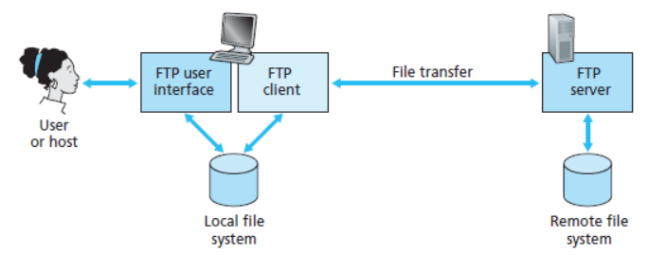
FTP (File Transfer Protocol)
FTP (File Transfer Protocol) is a protocol for transferring a file from one host to another host.
In order for the user to access the remote account, the user must provide a user identification and a password. After providing this authorization information, the user can transfer files from the local file system to the remote file system and vice versa.
the user interacts with FTP through an FTP user agent. The user first provides the hostname of the remote host, causing the FTP client process in the local host to establish a TCP connection with the FTP server process in the remote host.
The user then provides the user identification and password, which are sent over the TCP connection as part of FTP commands.
Once the server has authorized the user, the user copies one or more files stored in the local file system into the remote file system (or vice versa).

Slide 42
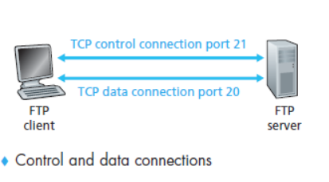
HTTP and FTP are both file transfer protocols and have many common characteristics; for example, they both run on top of TCP. However, the two application-layer protocols have some important differences.
The most difference is that FTP uses two parallel TCP connections to transfer a file, a control connection and a data connection.
The control connection is used for sending control information between the two hosts information such as user identification, password, commands to change remote directory, and commands to “put” and “get” files.
The data connection is used to actually send a file. Because FTP uses a separate control connection, FTP is said to send its control information out-of-band.
HTTP, as you recall, sends request and response header lines into the same TCP connection that carries the transferred file itself. For this reason, HTTP is said to send its control information in-band.

Slide 43
FTP Commands and Replies
The commands, from client to server, and replies, from server to client, are sent across the control connection in 7-bit ASCII format.
Each command consists of four uppercase ASCII characters, some with optional arguments. Some of the more common commands are given below:
USER username: Used to send the user identification to the server.
PASS password: Used to send the user password to the server.
LIST: Used to ask the server to send back a list of all the files in the current remote directory. The list of files is sent over a (new and non-persistent) data connection rather than the control TCP connection.
RETR filename: Used to retrieve (that is, get) a file from the current directory of the remote host. This command causes the remote host to initiate a data connection and to send the requested file over the data connection.
STOR filename: Used to store (that is, put) a file into the current directory of the remote host.
Each command is followed by a reply, sent from server to client. The replies are three-digit numbers, with an optional message following the number. Some replies, along with their possible messages, are as follows:
• 331 Username OK, password required
• 125 Data connection already open; transfer starting
• 425 Can’t open data connection
• 452 Error writing file

Slide 44
Application layer: overview
P2P applications
video streaming and content distribution networks
socket programming with UDP and TCP
Principles of network applications
Web and HTTP
E-mail, SMTP, POP3,IMAP
The Domain Name System DNS

Slide 45
E-mail
user
agent
Three major components:
user agents
mail servers
simple mail transfer protocol: SMTP
User Agent
a.k.a. “mail reader”
composing, editing, reading mail messages
e.g., Outlook, iPhone mail client
outgoing, incoming messages stored on server
mail
server
user
agent
SMTP
mail
server
user
agent
SMTP
SMTP
user
agent
mail
server
user
agent
user
agent
outgoing
message queue
user mailbox

Slide 46
E-mail: mail servers
user
agent
mail servers:
mailbox contains incoming messages for user
message queue of outgoing (to be sent) mail messages
SMTP protocol between mail servers to send email messages
client: sending mail server
“server”: receiving mail server
mail
server
user
agent
SMTP
mail
server
user
agent
SMTP
SMTP
user
agent
mail
server
user
agent
user
agent
outgoing
message queue
user mailbox

Slide 47
SMTP RFC (5321)
“client”
SMTP server
“server”
SMTP server
uses TCP to reliably transfer email message from client (mail server initiating connection) to server, port 25
direct transfer: sending server (acting like client) to receiving server
three phases of transfer
SMTP handshaking (greeting)
SMTP transfer of messages
SMTP closure
command/response interaction (like HTTP)
commands: ASCII text
response: status code and phrase
initiate TCP
connection
RTT
TCP connection
initiated
220
SMTP handshaking
HELO
250 Hello
SMTP transfers
time

Slide 48


Scenario: Alice sends e-mail to Bob
1) Alice uses UA to compose e-mail message “to” bob@someschool.edu
4) SMTP client sends Alice’s message over the TCP connection
2) Alice’s UA sends message to her mail server using SMTP; message placed in message queue
5) Bob’s mail server places the message in Bob’s mailbox
3) client side of SMTP at mail server opens TCP connection with Bob’s mail server
6) Bob invokes his user agent to read message
user
agent
mail
server
user
agent
1
mail
server
2
3
6
4
Alice’s mail server
5
Bob’s mail server

Slide 49
Sample SMTP interaction
S: 220 hamburger.edu
C: HELO crepes.fr
S: 250 Hello crepes.fr, pleased to meet you
C: MAIL FROM: <alice@crepes.fr>
S: 250 alice@crepes.fr... Sender ok
C: RCPT TO: <bob@hamburger.edu>
S: 250 bob@hamburger.edu ... Recipient ok
C: DATA
S: 354 Enter mail, end with "." on a line by itself
C: Do you like ketchup?
C: How about pickles?
C: .
S: 250 Message accepted for delivery
C: QUIT
S: 221 hamburger.edu closing connection

Slide 50
SMTP: observations
comparison with HTTP:
HTTP: client pull
SMTP: client push
both have ASCII command/response interaction, status codes
HTTP: each object encapsulated in its own response message
SMTP: multiple objects sent in multipart message
SMTP uses persistent connections
SMTP requires message (header & body) to be in 7-bit ASCII
SMTP server uses CRLF.CRLF to determine end of message

Slide 51
Mail message format
SMTP: protocol for exchanging e-mail messages, defined in RFC 5321 (like RFC 7231 defines HTTP)
RFC 2822 defines syntax for e-mail message itself (like HTML defines syntax for web documents)
header lines, e.g.,
To:
From:
Subject:
these lines, within the body of the email message area different from SMTP MAIL FROM:, RCPT TO: commands!
Body: the “message” , ASCII characters only
header
blank
line
body

Slide 52
Retrieving email: mail access protocols
user
agent
e-mail access
protocol
user
agent
SMTP
SMTP
(e.g., IMAP, HTTP)
sender’s e-mail
server
receiver’s e-mail
server
SMTP: delivery/storage of e-mail messages to receiver’s server
mail access protocol: retrieval from server
IMAP: Internet Mail Access Protocol [RFC 3501]: messages stored on server, IMAP provides retrieval, deletion, folders of stored messages on server
HTTP: gmail, Hotmail, Yahoo!Mail, etc. provides web-based interface on top of STMP (to send), IMAP (or POP) to retrieve e-mail messages

Slide 53
POP3
POP3 is an extremely simple mail access protocol. It is defined in [RFC 1939], which is short and quite readable.
POP3 begins when the user agent (the client) opens a TCP connection to the mail server (the server) on port 110. With the TCP connection established, POP3 progresses through three phases:
authorization,
transaction, and
update.
During authorization, the user agent sends a username and a password (in the clear) to authenticate the user.
During the transaction, the user agent retrieves messages; also during this phase, the user agent can mark messages for deletion, remove deletion marks, and obtain mail statistics.
The third phase, update, occurs after the client has issued the quit command, ending the POP3 session; at this time, the mail server deletes the messages that were marked for deletion.

Slide 54
In a POP3 transaction, the user agent issues commands, and the server responds to each command with a reply.
There are two possible responses:
+OK (sometimes followed by server-to-client data), used by the server to indicate that the previous command was fine;
-ERR, used by the server to indicate that something was wrong with the previous command.
The authorization phase has two principal commands: user <username> and pass <password>. To illustrate these two commands, we suggest that you Telnet directly into a POP3 server, using port 110, and issue these commands.
telnet mailServer 110
+OK POP3 server ready
user bob
+OK
pass hungry
+OK user successfully logged on

Slide 55
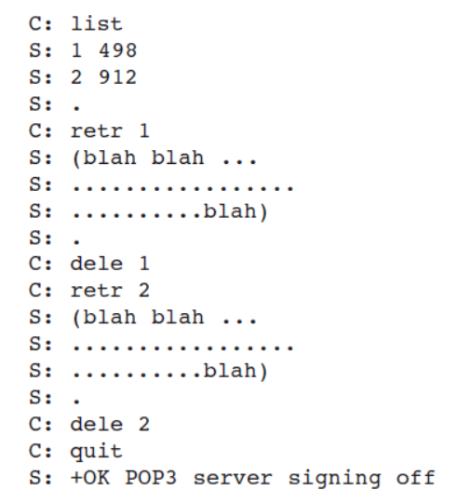
At the transaction phase.
A user agent using POP3 can often be configured (by the user) to “download and delete” or to “download and keep.”
The sequence of commands issued by a POP3 user agent depends on which of these two modes the user agent is operating in.
In the download-and-delete mode, the user agent will issue the list, retr, and dele commands.
As an example, suppose the user has two messages in his or her mailbox. In the dialogue below, C: (standing for client) is the user agent and S: (standing for server) is the mail server.
The transaction will look something like:

Slide 56
POP3 protocol
S: +OK POP3 server ready
C: user bob
S: +OK
C: pass hungry
S: +OK user successfully logged on
authorization phase
client commands:
user: declare username
pass: password
server responses
+OK
-ERR
transaction phase, client:
list: list message numbers
retr: retrieve message by number
dele: delete
quit
C: list
S: 1 498
S: 2 912
S: .
C: retr 1
S: <message 1 contents>
S: .
C: dele 1
C: retr 2
S: <message 1 contents>
S: .
C: dele 2
C: quit
S: +OK POP3 server signing off

Slide 57
POP3 (more) and IMAP
more about POP3
previous example uses POP3 “download and delete” mode
Bob cannot re-read e-mail if he changes client
POP3 “download-and-keep”: copies of messages on different clients
POP3 is stateless across sessions
IMAP
keeps all messages in one place: at server
allows user to organize messages in folders
keeps user state across sessions:
names of folders and mappings between message IDs and folder name

Slide 58
IMAP
With POP3 access, once Bob has downloaded his messages to the local machine, he can create mail folders and move the downloaded messages into the folders. Bob can then delete messages, move messages across folders, and search for messages (by sender name or subject).
But this paradigm—namely, folders and messages in the local machine—poses a problem for the nomadic user, who would prefer to maintain a folder hierarchy on a remote server that can be accessed from any computer. This is not possible with POP3—the POP3 protocol does not provide any means for a user to create remote folders and assign messages to folders.
To solve this and other problems, the IMAP protocol, defined in [RFC 3501], was invented. Like POP3, IMAP is a mail access protocol. It has many more features than POP3, but it is also significantly more complex. (And thus the client and server side implementations are significantly more complex.)

Slide 59
An IMAP server will associate each message with a folder; when a message first arrives at the server, it is associated with the recipient’s INBOX folder. The recipient can then move the message into a new, user-created folder, read the message, delete the message, and so on.
The IMAP protocol provides commands to allow users to create folders and move messages from one folder to another. IMAP also provides commands that allow users to search remote folders for messages matching specific criteria.
Note that, unlike POP3, an IMAP server maintains user state information across IMAP sessions—for example, the names of the folders and which messages are associated with which folders.
Another important feature of IMAP is that it has commands that permit a user agent to obtain components of messages. For example, a user agent can obtain just the message header of a message or just one part of a multipart MIME message.
This feature is useful when there is a low-bandwidth connection (for example, a slow-speed modem link) between the user agent and its mail server. With a low bandwidth connection, the user may not want to download all of the messages in its mailbox, particularly avoiding long messages that might contain, for example, an audio or video clip.

Slide 60
MIME Protocol
MIME stands for Multipurpose Internet Mail Extensions. It is used to extend the capabilities of Internet e-mail protocols such as SMTP.
The MIME protocol allows the users to exchange various types of digital content such as pictures, audio, video, and various types of documents and files in the e-mail.
Why do we need MIME? Limitations of Simple Mail Transfer Protocol (SMTP):
SMTP has a very simple structure
Its comes with a price as it only sends messages in Network Virtual Terminal(NVT) 7-bit ASCII format.
It cannot be used for languages that do not support 7-bit ASCII format such as French, German, Russian, Chinese and Japanese, etc.
It cannot be used to send binary files or video or audio data.

Slide 61
Features of MIME
It is able to send multiple attachments with a single message.
Unlimited message length.
Binary attachments (executables, images, audio, or video files) may be divided if needed.
MIME provided support for varying content types and multi-part messages.

Slide 62
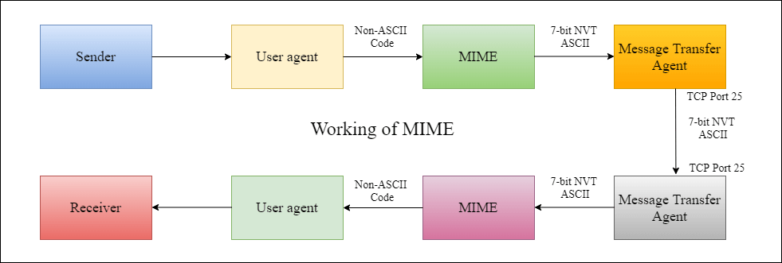
Working of MIME
Suppose a user wants to send an email through a user agent and it is in a non-ASCII format so there is a MIME protocol that converts it into 7-bit NVT ASCII format.
The message is transferred through the e-mail system to the other side in the 7-bit format now MIME protocol again converts it back into non-ASCII code and now the user agent of the receiver side reads it and then information is finally read by the receiver.
MIME header is basically inserted at the beginning of any e-mail transfer.

Slide 63
MIME with SMTP and POP
SMTP transfers the mail being a message transfer agent from the sender’s side to the mailbox of the receiver side and stores it and MIME header is added to the original header and provides additional information.
while POP being the message access agent organizes the mails from the mail server to the receiver’s computer. POP allows the user agent to connect with the message transfer agent

Slide 64
MIME Header
MIME Header: It is added to the original e-mail header section to define transformation. There are five headers that we add to the original header:
MIME-Version – Defines the version of the MIME protocol. It must have the parameter Value 1.0, which indicates that message is formatted using MIME.
Content-Type – Type of data used in the body of the message. They are of different types like text data (plain, HTML), audio content, or video content.
Content-Type Encoding – It defines the method used for encoding the message. Like 7-bit encoding, 8-bit encoding, etc.
Content Id – It is used for uniquely identifying the message.
Content description – It defines whether the body is actually an image, video, or audio

Slide 65
Application Layer: Overview
P2P applications
video streaming and content distribution networks
socket programming with UDP and TCP
Principles of network applications
Web and HTTP
E-mail, SMTP, IMAP
The Domain Name System DNS

Slide 66
DNS: Domain Name System
people: many identifiers:
SSN, name, passport #
Internet hosts, routers:
IP address (32 bit) - used for addressing datagrams
“name”, e.g., cs.umass.edu - used by humans
Q: how to map between IP address and name, and vice versa ?
Domain Name System (DNS):
distributed database implemented in hierarchy of many name servers
application-layer protocol: hosts, DNS servers communicate to resolve names (address/name translation)
note: core Internet function, implemented as application-layer protocol
complexity at network’s “edge”

Slide 67
DNS: services, structure
DNS services:
hostname-to-IP-address translation
host aliasing
canonical, alias names
mail server aliasing
load distribution
replicated Web servers: many IP addresses correspond to one name
Q: Why not centralize DNS?
single point of failure
traffic volume
distant centralized database
maintenance
A: doesn‘t scale!
Comcast DNS servers alone: 600B DNS queries/day
Akamai DNS servers alone: 2.2T DNS queries/day

Slide 68

Thinking about the DNS
humongous distributed database:
~ billion records, each simple
handles many trillions of queries/day:
many more reads than writes
performance matters: almost every Internet transaction interacts with DNS - msecs count!
organizationally, physically decentralized:
millions of different organizations responsible for their records
“bulletproof”: reliability, security

Slide 69
DNS: a distributed, hierarchical database
Root DNS Servers
Root
…
…
.com DNS servers
.org DNS servers
.edu DNS servers
Top Level Domain
…
…
…
…
yahoo.com
DNS servers
amazon.com
DNS servers
pbs.org
DNS servers
nyu.edu
DNS servers
umass.edu
DNS servers
Authoritative
Client wants IP address for www.amazon.com; 1st approximation:
client queries root server to find .com DNS server
client queries .com DNS server to get amazon.com DNS server
client queries amazon.com DNS server to get IP address for www.amazon.com

Slide 70
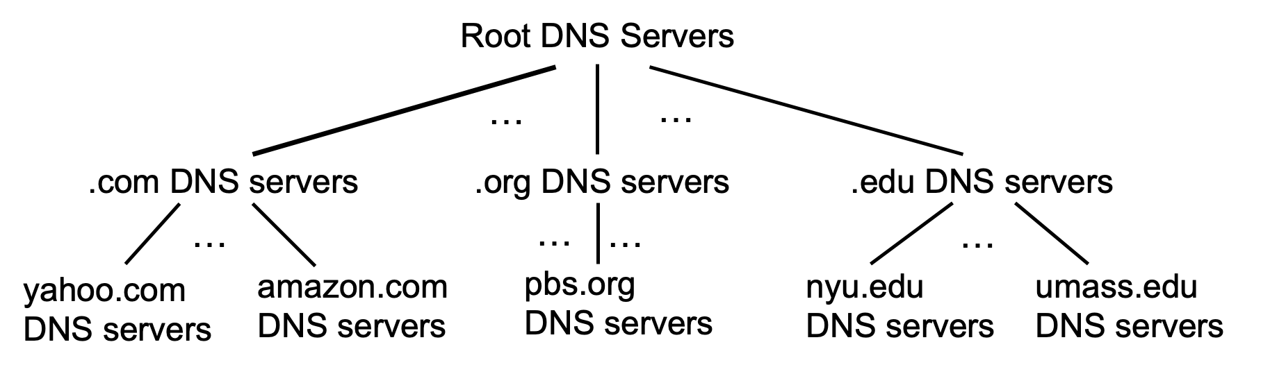
DNS: root name servers
official, contact-of-last-resort by name servers that can not resolve name

Slide 71
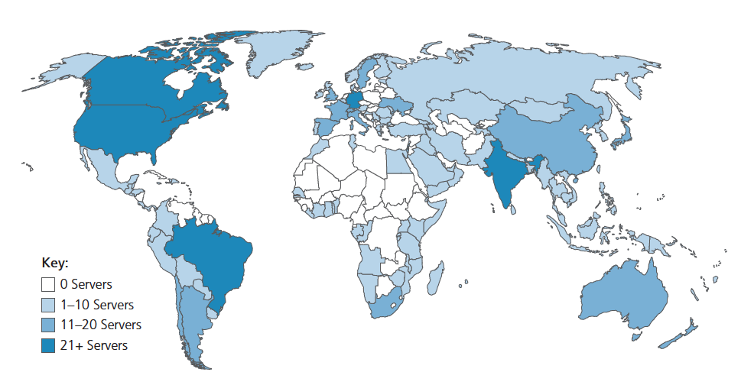
DNS: root name servers
official, contact-of-last-resort by name servers that can not resolve name
incredibly important Internet function
Internet couldn’t function without it!
DNSSEC – provides security (authentication, message integrity)
ICANN (Internet Corporation for Assigned Names and Numbers) manages root DNS domain
13 logical root name “servers” worldwide each “server” replicated many times (~200 servers in US)

Slide 72
Top-Level Domain, and authoritative servers
Top-Level Domain (TLD) servers:
responsible for .com, .org, .net, .edu, .aero, .jobs, .museums, and all top-level country domains, e.g.: .cn, .uk, .fr, .ca, .jp
Network Solutions: authoritative registry for .com, .net TLD
Educause: .edu TLD
authoritative DNS servers:
organization’s own DNS server(s), providing authoritative hostname to IP mappings for organization’s named hosts
can be maintained by organization or service provider

Slide 73
Local DNS name servers
when host makes DNS query, it is sent to its local DNS server
Local DNS server returns reply, answering:
from its local cache of recent name-to-address translation pairs (possibly out of date!)
forwarding request into DNS hierarchy for resolution
each ISP has local DNS name server; to find yours:
MacOS: % scutil --dns
Windows: >ipconfig /all
local DNS server doesn’t strictly belong to hierarchy

Slide 74
DNS name resolution: iterated query
root DNS server
Example: host at engineering.nyu.edu wants IP address for gaia.cs.umass.edu
2
3
TLD DNS server
Iterated query:
contacted server replies with name of server to contact
“I don’t know this name, but ask this server”
1
4
8
5
requesting host at
engineering.nyu.edu
local DNS server
dns.nyu.edu
gaia.cs.umass.edu
7
6
authoritative DNS server
dns.cs.umass.edu

Slide 75
DNS name resolution: recursive query
root DNS server
Example: host at engineering.nyu.edu wants IP address for gaia.cs.umass.edu
2
3
7
6
Recursive query:
puts burden of name resolution on contacted name server
heavy load at upper levels of hierarchy?
1
TLD DNS server
8
requesting host at
engineering.nyu.edu
local DNS server
dns.nyu.edu
5
4
gaia.cs.umass.edu
authoritative DNS server
dns.cs.umass.edu

Slide 76
Caching DNS Information
once (any) name server learns mapping, it caches mapping, and immediately returns a cached mapping in response to a query
caching improves response time
cache entries timeout (disappear) after some time (TTL)
TLD servers typically cached in local name servers
cached entries may be out-of-date
if named host changes IP address, may not be known Internet-wide until all TTLs expire!
best-effort name-to-address translation!

Slide 77
DNS records
DNS: distributed database storing resource records (RR)
RR format: (name, value, type, ttl)
type=A
name is hostname
value is IP address
type=CNAME
name is alias name for some “canonical” (the real) name
www.ibm.com is really servereast.backup2.ibm.com
value is canonical name
type=NS
name is domain (e.g., foo.com)
value is hostname of authoritative name server for this domain
type=MX
value is name of SMTP mail server associated with name

Slide 78
DNS protocol messages
DNS query and reply messages, both have same format:
2 bytes
2 bytes
message header:
identification: 16 bit # for query, reply to query uses same #
flags:
query or reply
recursion desired
recursion available
reply is authoritative
identification
flags
# questions
# answer RRs
# authority RRs
# additional RRs
questions (variable # of questions)
answers (variable # of RRs)
authority (variable # of RRs)
additional info (variable # of RRs)

Slide 79
DNS protocol messages
DNS query and reply messages, both have same format:
2 bytes
2 bytes
identification
flags
# questions
# answer RRs
# authority RRs
# additional RRs
name, type fields for a query
questions (variable # of questions)
RRs in response to query
answers (variable # of RRs)
records for authoritative servers
authority (variable # of RRs)
additional “ helpful” info that may be used
additional info (variable # of RRs)

Slide 80
Getting your info into the DNS
example: new startup “Network Utopia”
register name networkuptopia.com at DNS registrar (e.g., Network Solutions)
provide names, IP addresses of authoritative name server (primary and secondary)
registrar inserts NS, A RRs into .com TLD server:
(networkutopia.com, dns1.networkutopia.com, NS)
(dns1.networkutopia.com, 212.212.212.1, A)
create authoritative server locally with IP address 212.212.212.1
type A record for www.networkuptopia.com
type MX record for networkutopia.com

Slide 81
DNS security
DDoS attacks
bombard root servers with traffic
not successful to date
traffic filtering
local DNS servers cache IPs of TLD servers, allowing root server bypass
bombard TLD servers
potentially more dangerous
Spoofing attacks
intercept DNS queries, returning bogus replies
DNS cache poisoning
RFC 4033: DNSSEC authentication services

Slide 82
Sample SMTP interaction
S: 220 hamburger.edu
C: HELO crepes.fr
S: 250 Hello crepes.fr, pleased to meet you
C: MAIL FROM: <alice@crepes.fr>
S: 250 alice@crepes.fr... Sender ok
C: RCPT TO: <bob@hamburger.edu>
S: 250 bob@hamburger.edu ... Recipient ok
C: DATA
S: 354 Enter mail, end with "." on a line by itself
C: Do you like ketchup?
C: How about pickles?
C: .
S: 250 Message accepted for delivery
C: QUIT
S: 221 hamburger.edu closing connection
Notes:
Retired this slide, since telnet isn’t really used anymore, and few non https: mail servers around anymore....

Slide 83
Case study: Netflix
Amazon cloud
upload copies of multiple versions of video to CDN servers
CDN
server
Netflix registration,
accounting servers
Bob browses
Netflix video
Manifest file, requested
returned for
specific video
CDN
server
2
1
3
Bob manages Netflix account
CDN
server
4
DASH server selected, contacted, streaming begins
Notes:
This slide retired, since there’s the new Netflix example which is visually better

Slide 84
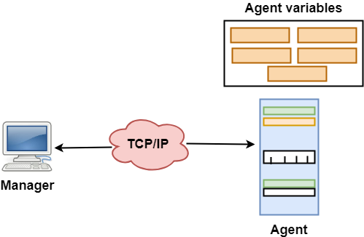
SNMP
SNMP stands for Simple Network Management Protocol.
SNMP is an application layer protocol that uses UDP port number 161/162.SNMP is used to monitor the network, detect network faults, and sometimes even used to configure remote devices
SNMP has two components Manager and agent.
The manager is a host that controls and monitors a set of agents such as routers.
It is an application layer protocol in which a few manager stations can handle a set of agents.
The protocol designed at the application level can monitor the devices made by different manufacturers and installed on different physical networks.
It is used in a heterogeneous network made of different LANs and WANs connected by routers or gateways.

Slide 85
Managers & Agents
A manager is a host that runs the SNMP client program while the agent is a router that runs the SNMP server program.
Management of the internet is achieved through simple interaction between a manager and agent.
The agent is used to keep the information in a database while the manager is used to access the values in the database. For example, a router can store the appropriate variables such as a number of packets received and forwarded while the manager can compare these variables to determine whether the router is congested or not.
Agents can also contribute to the management process. A server program on the agent checks the environment, if something goes wrong, the agent sends a warning message to the manager.

Slide 86
Management with SNMP has three basic ideas:
A manager checks the agent by requesting the information that reflects the behavior of the agent.
A manager also forces the agent to perform a certain function by resetting values in the agent database.
An agent also contributes to the management process by warning the manager regarding an unusual condition

Slide 87
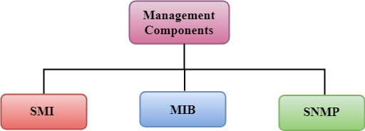
Management Components
Management is not achieved only through the SNMP protocol but also the use of other protocols that can cooperate with the SNMP protocol. Management is achieved through the use of the other two protocols: SMI (Structure of management information) and MIB(management information base).
Management is a combination of SMI, MIB, and SNMP. All these three protocols such as abstract syntax notation 1 (ASN.1) and basic encoding rules (BER).

Slide 88
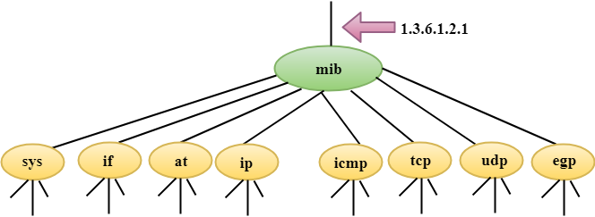
SMI
The SMI (Structure of management information) is a component used in network management. Its main function is to define the type of data that can be stored in an object and to show how to encode the data for the transmission over a network.
MIB
The MIB (Management information base) is a second component for the network management.
Each agent has its own MIB, which is a collection of all the objects that the manager can manage. MIB is categorized into eight groups: system, interface, address translation, ip, icmp, tcp, udp, and egp. These groups are under the mib object.

Slide 89
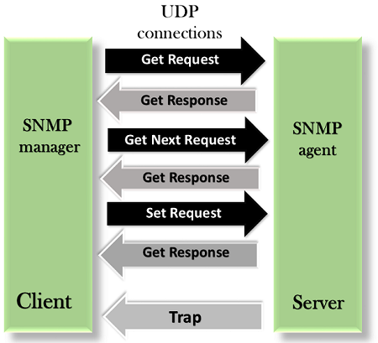
SNMP messages
SNMP defines five types of messages: GetRequest, GetNextRequest, SetRequest, GetResponse, and Trap
GetRequest: The GetRequest message is sent from a manager (client) to the agent (server) to retrieve the value of a variable.
GetResponse: The GetResponse message is sent from an agent to the manager in response to the GetRequest and GetNextRequest message. This message contains the value of a variable requested by the manager.
GetNextRequest: The GetNextRequest message is sent from the manager to agent to retrieve the value of a variable. This type of message is used to retrieve the values of the entries in a table.
SetRequest: The SetRequest message is sent from a manager to the agent to set a value in a variable.
Trap: The Trap message is sent from an agent to the manager to report an event. For example, if the agent is rebooted, then it informs the manager as well as sends the time of rebooting

